Slide 1
Capstone Presentation
Jacob Posz

Slide 2
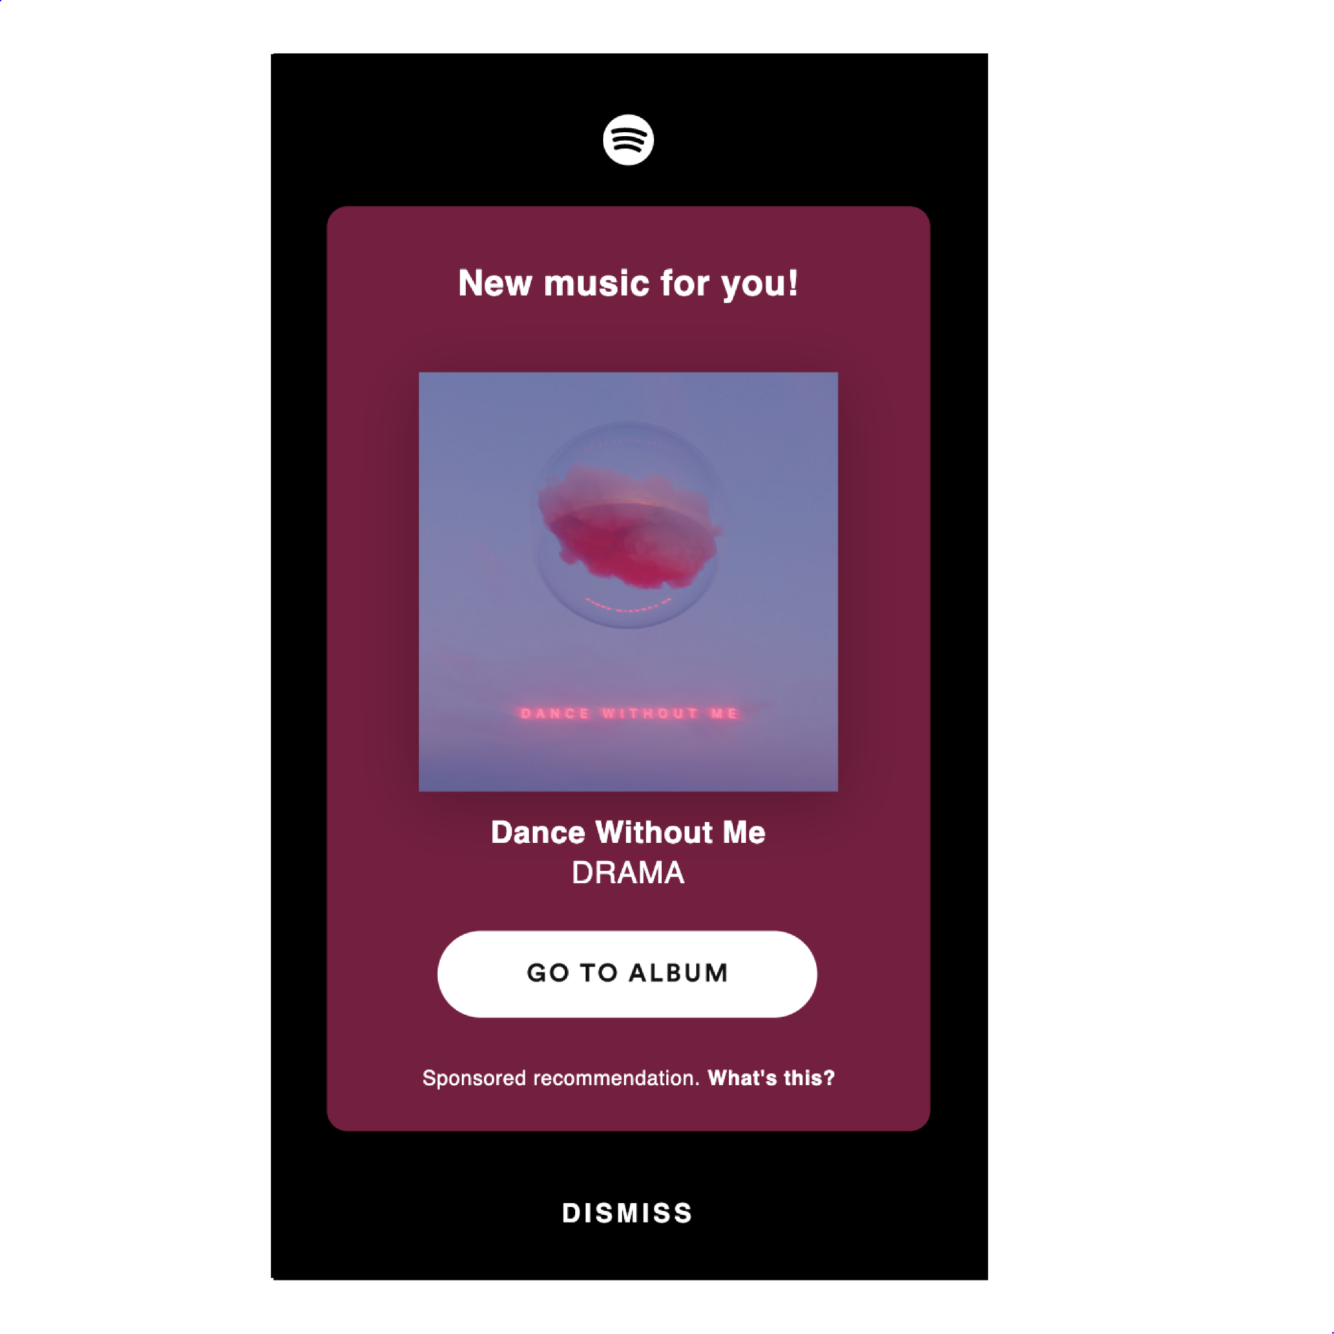
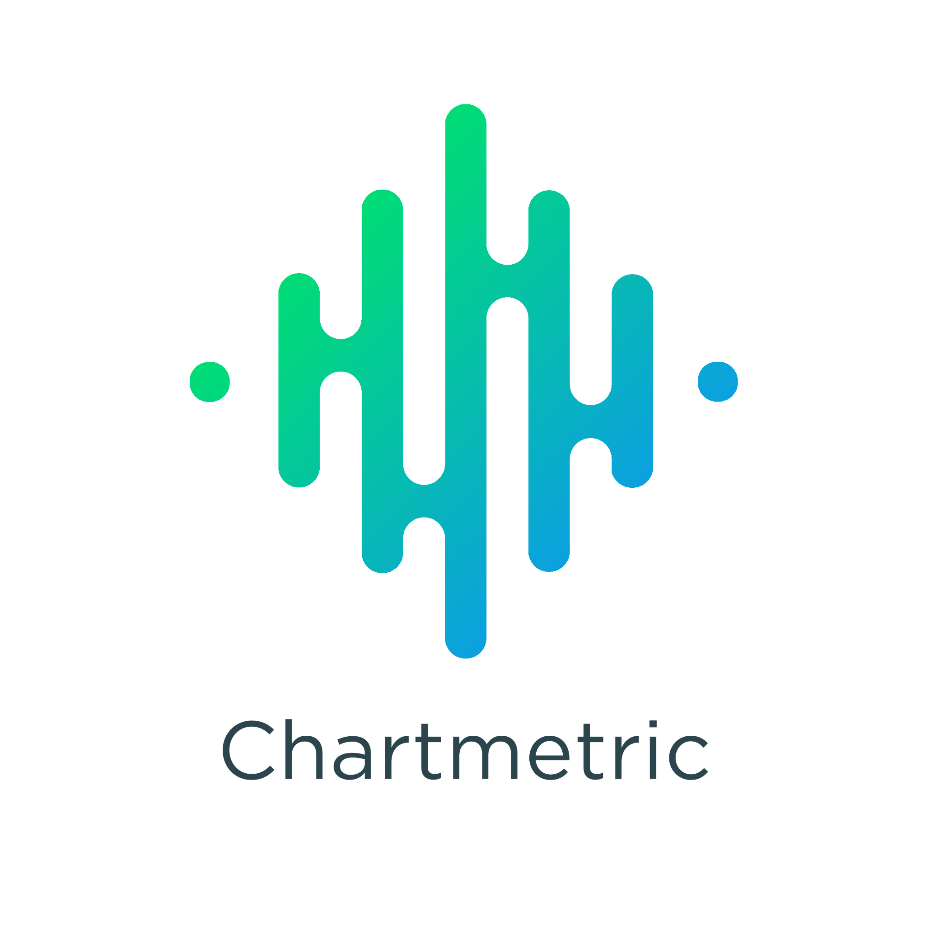
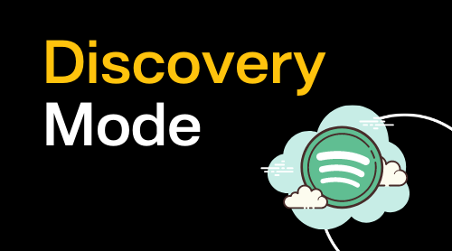
Start (Jan 31)
Release Day
Pitch Stage
Promotion Stage
Growth Stage
April 31
30 Days
30 Days
30 Days
Notes:
For my capstone project, a single song campaign was run with a musician that I currently help manage and broke the campaign down into 3 stages (30 days for each stage and 90 days total) with the eventual goal of getting the single onto a Spotify editorial playlist.

Slide 3
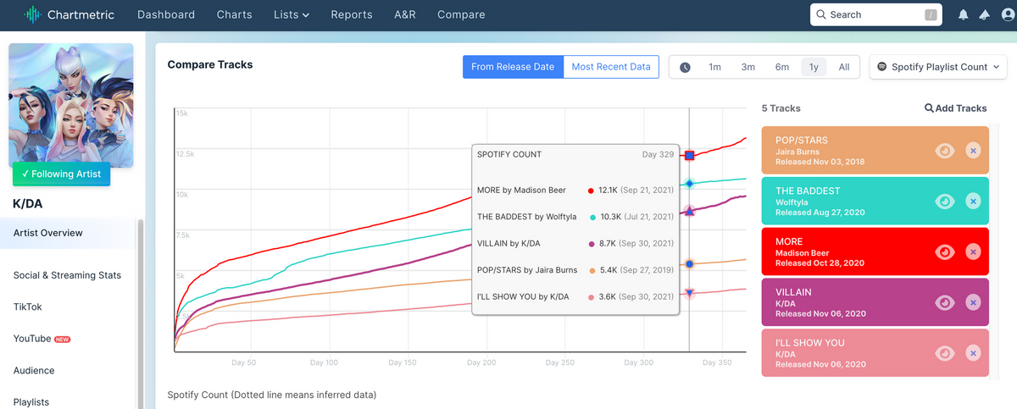
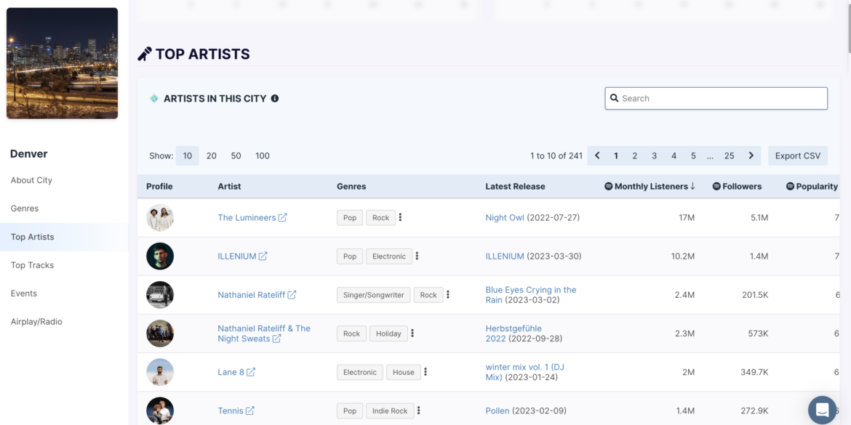
Stage 1 - Pitch Stage (Days 0-30)
Chartmetric (pre-release) - musical database
Used it to find correct micro-genre(s) -> find the correct playlists to target
Playlist journey feature
tracks the “journey” of all songs on a targeted playlist
Found the correct Hyperpop, Indietronica and bedroom pop playlists to pitch to
Notes:
What is a Spotify editorial playlist and why is this step so important?
Well, according to Spotify, editorial playlists are playlists that are curated by Spotify's Shows & Editorial team. This is a team of music experts and genre specialists from around the world, hired by Spotify to curate and manage Spotify's own playlists.
These playlists can make or break a new artist’s career by the sheer amount of listeners these playlists have.
By pitching your artist’s song to Spotify early on (at least 1 month prior to release day), you're giving Spotify’s editors the best chance to listen and playlist your artist’s song. However, you can only pitch your artist’s song to Spotify's Editorial Team pre-release so it's crucial to get the timing correct.
The tool that I used for this stage was a database called Chartmetric
I used it to figure out what micro-genre(s) my artist fell under so that I could figure out the correct playlists to target when pitching my artist’s song to Spotify (suggesting the exact name of the playlist you think the song should be on is highly recommended).
The feature I utilized the most on Chartmetric was its “Playlist Journey” feature… This feature essentially tracks the “journey” of all songs on a targeted playlist; it visualizes the tracks’ commonly occurring playlists and displays the percentage overlap between the playlists.
Through Chartmetric’s “Playlist Journey” feature, I ended up figuring out that my artist’s song fell under the micro-genre of “hyperpop,” “indietronica” and “bedroom pop”; all three of which I had never heard of / did not know existed prior to using Chartmetric.
Moreover, through the “Playlist Journey” feature, I ended up finding a few smaller Spotify curated playlists that fit my artist’s single’s micro-genres; we ended up pitching to these playlists.

Slide 4
Stage 2 - Promotion Stage (Days 31-60)
Spotify’s Marquee tool (post-release)
Reached (people who saw the campaign) 1,712 listeners
233 clicks (clicks to the release)
149 converted listeners (people who streamed the release after seeing the campaign)
8.68% conversion rate (percentage of people streamed the release after seeing the campaign)
8.71 streams / listener (average number of active streams per converted listener who streamed the song after seeing the campaign)
39.6% intent rate (number of converted listeners who saved or playlisted the song after streaming)
28 total playlists adds for the song
30.2% save rate (number of of converted listeners who saved a track).
Notes:
This second stage was the promotion stage (days 31-60)
This stage is crucial because according to Spotify, if your artist’s song wasn’t originally picked by an editorial playlist curator prior to release day, the song still has a chance to get picked for an editorial playlist based on the song’s first month performance. Taking this into consideration, precautions were taken to make sure the proper tool was used (recommended by Spotify) to correctly promote the artist’s single during the first month post release.
The tool used was Spotify’s Marquee tool
Spotify’s Marquee tool is a full-screen, sponsored recommendation of an artist’s new release to Spotify Free and Premium listeners who have shown interest in an artist’s music and have the potential to listen more. When a listener clicks on an artist’s Marquee, they are guided to that artist’s new release—and that artist’s release alone.
results:
1,712 listeners saw the campaign
233 people clicked on the release
149 people streamed the release after seeing the campaign
8.68% of people streamed the release after seeing the campaign
8.71 streams on average per converted listener who streamed the song after seeing the campaign
39.6% of converted listeners who saved or playlisted the song after streaming
28 total playlists adds for the song
30.2% of converted listeners saved the track

Slide 5
Stage 3 - Growth Stage (Days 61-90)
Spotify’s ‘Discovery Mode’ tool (post-release)
More algorithmic exposure on Spotify through Spotify Radio and autoplay.
The only caveat being a lower royalty rate
Through Discovery Mode, the artist's single gained:
3,498 new listeners
6,594 streams
44 saves
29 playlist adds
260% listener lift
275% stream lift
a 1.48% intent rate
Notes:
Lastly, the growth stage is pivotal in driving traffic to an artist’s Spotify profile through an artist’s new single. Regardless of whether an artist’s single was selected by a Spotify editorial curator or not, it's important to keep driving traffic to your artist’s single during the second month post release.
The tool used for the growth stage was Spotify’s ‘Discovery Mode’ tool
‘Discovery Mode’ was used for my artist to give his song more algorithmic exposure on Spotify through Spotify Radio and autoplay.
The only caveat being a lower royalty rate (however, I wasn’t too concerned about this for this project)
results:
3,498 new listeners
6,594 streams
44 saves
29 playlist adds
260% listener lift
275% stream lift
a 1.48% intent rate (the percentage of listeners who saved or playlisted the track after streaming it)

Slide 6
Conclusion - Did I get my Artist’s single onto an editorial playlist?
In conclusion, I did not succeed in getting the artist’s single onto a Spotify editorial playlist.
However, that doesn't make this project a complete failure
According to Spotify, they receive 49,000 new song pitches per day and less than 1% of them get onto Spotify editorial playlists.
I’m competing with artists signed to major labels
Although getting the artist’s single onto a Spotify editorial playlist was unsuccessful, driving future traffic to the artist’s Spotify profile was successful; by pitching the artist’s song to the right playlist (through researching and parsing through databases like Chartmetric), promoting it to 1,712 new listeners (through Spotify's ‘Marquee’ tool) and growing it by over 6,500 streams (through Spotify’s ‘Discover Mode’ tool).
I also set the artist up for downstream traffic to that artist’s upcoming gigs, merchandise, future releases and stream revenue
Notes:
In conclusion, I did not succeed in getting the artist’s single onto a Spotify editorial playlist.
However, that doesn't make this project a complete failure; I’d say that it is quite the opposite actually.
According to Spotify, they receive 49,000 new song pitches per day and less than 1% of them get onto Spotify editorial playlists. In other words, it’s extremely difficult to get onto a Spotify editorial playlist.
Moreover, I’m competing with artists signed to major labels; the major labels have marketers / managers that personally know the curators of these editorial playlists and get their artist onto them essentially automatically. Therefore, it's close to impossible to get onto one as an independent artist; however, it does happen and that is why this lofty goal was set by myself
Although getting my artist’s single onto a Spotify editorial playlist was unsuccessful, driving future traffic to his Spotify profile was successful through pitching my artist’s song to the right playlist (through researching and parsing through databases like Chartmetric), promoting it to 1,712 new listeners (through Spotify's ‘Marquee’ tool) and growing it by over 6,500 streams (through Spotify’s ‘Discover Mode’ tool).
Not only did I successfully pitch, promote, and grow my artist’s single to the most listeners he’s ever seen before in a 1 month period, but I set him up for downstream traffic to future releases, merchandise, shows, and stream revenue

Slide 7
Thank You

